Slide 1
Use Case Class diagram Deployment Diagram
By Shinde Bhakti
19027

Slide 2

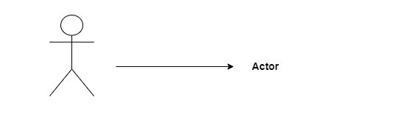
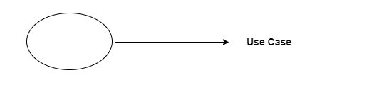
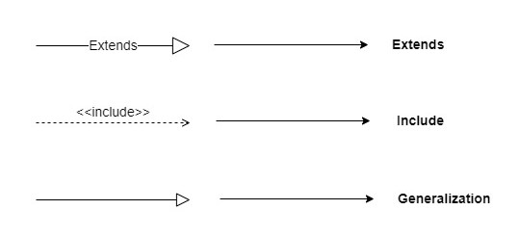
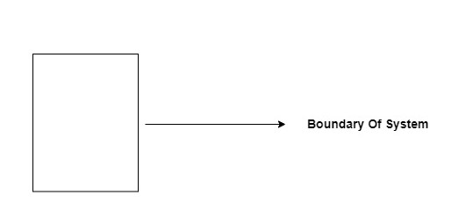
USE CASE
Use case in simple words is when you go to the tailor and tell them your need about your outfit the fitting the design so this way of explaining your ideas to someone in diagrammatical way is called Use Case.
So according to the project concept it is way to explain how a system can be used to achieve specific goals or tasks.

Slide 3
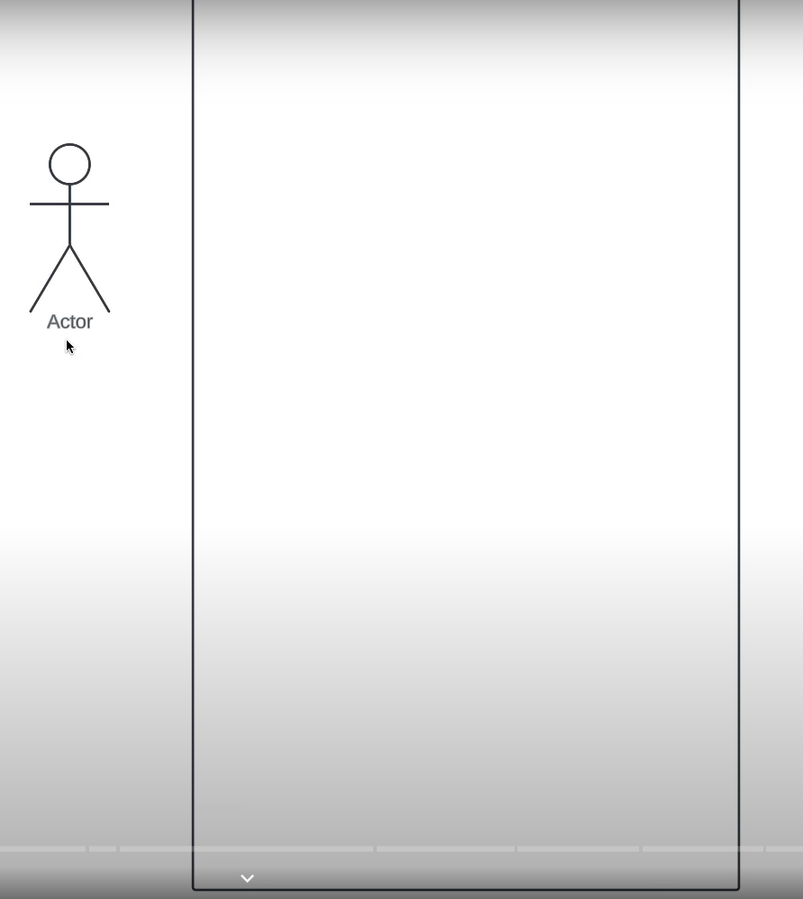
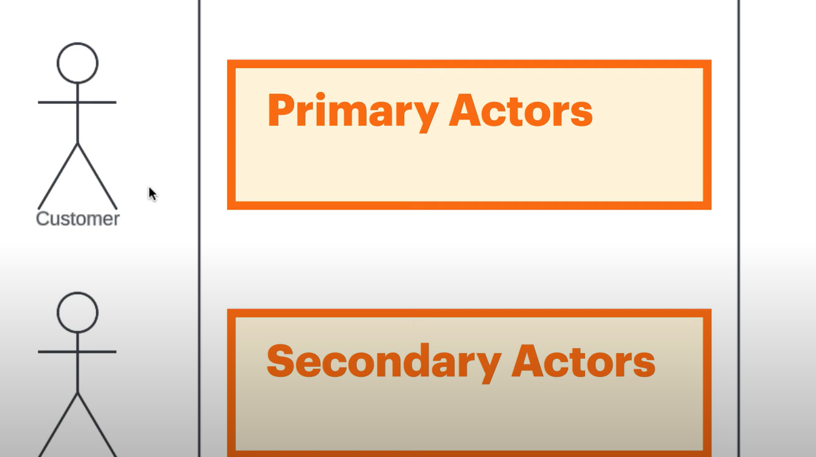
About Actor
Someone or something that uses our system to achieve a goal
For example:
Person
Organization
An external device
Another system
Actor need to place outside the system.
And need to categorized

Slide 4
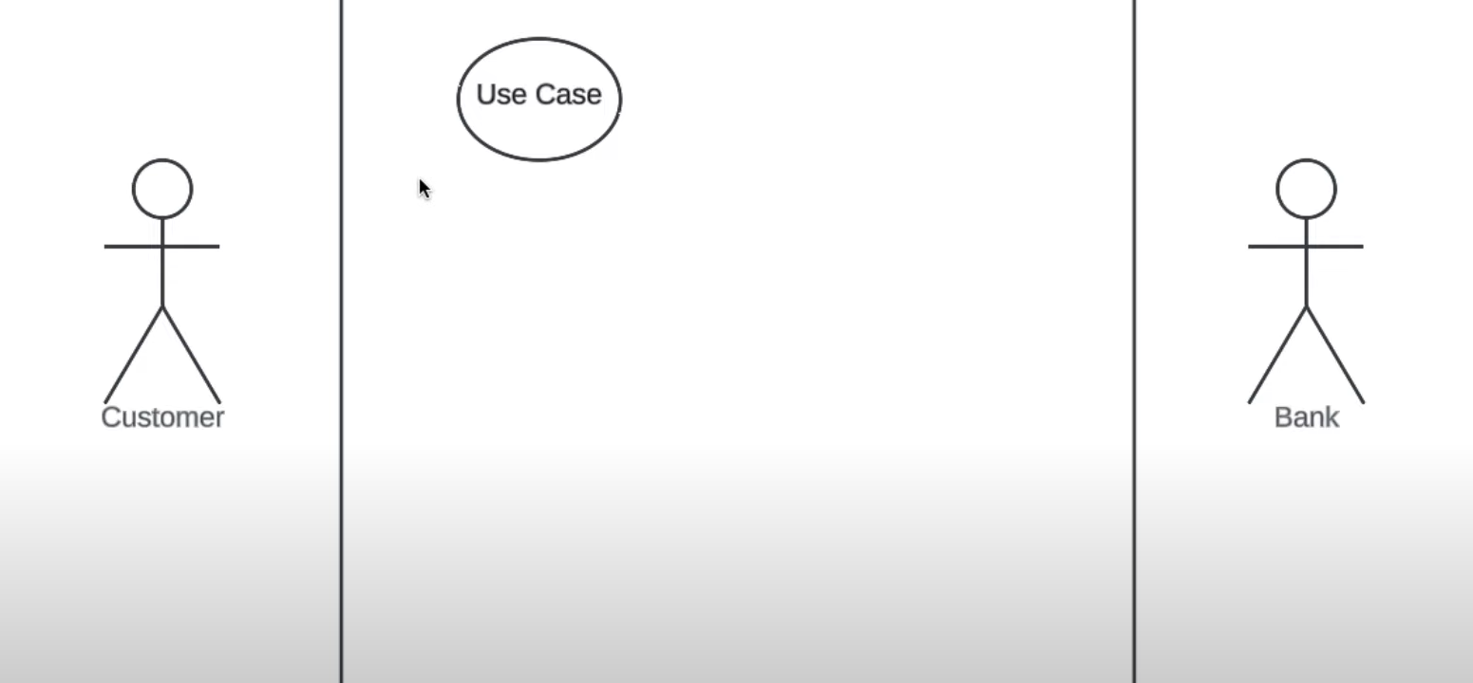
About Use Case
Represents an action that accomplishes some sort of task within the system.

Slide 5
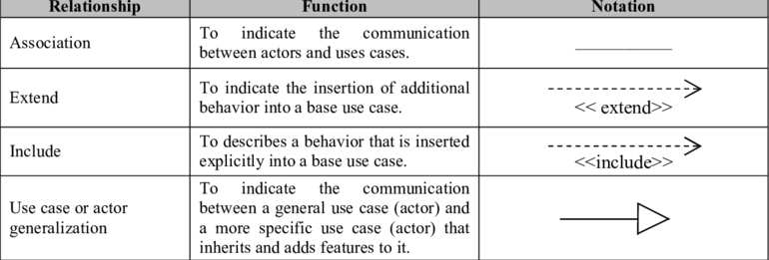
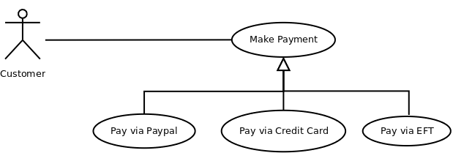

About Relationships

Slide 6
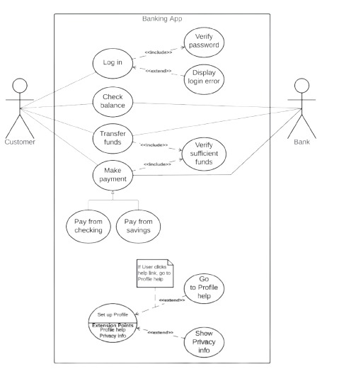
Example:

Slide 7
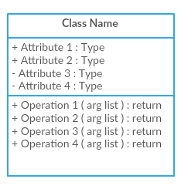
CLASS DIAGRAM
Class:
In a class diagram, a class is a box that represents a set of objects that share common features, constraints, and semantics
Attributes :
A significant piece of data containing values that describes each instance of that class. Also know as fields variables.
Operation:
Allow you to specify any behaviour features of class also known as functions
Visibility:
Private
+ public
# protected
~ package (default)

Slide 8
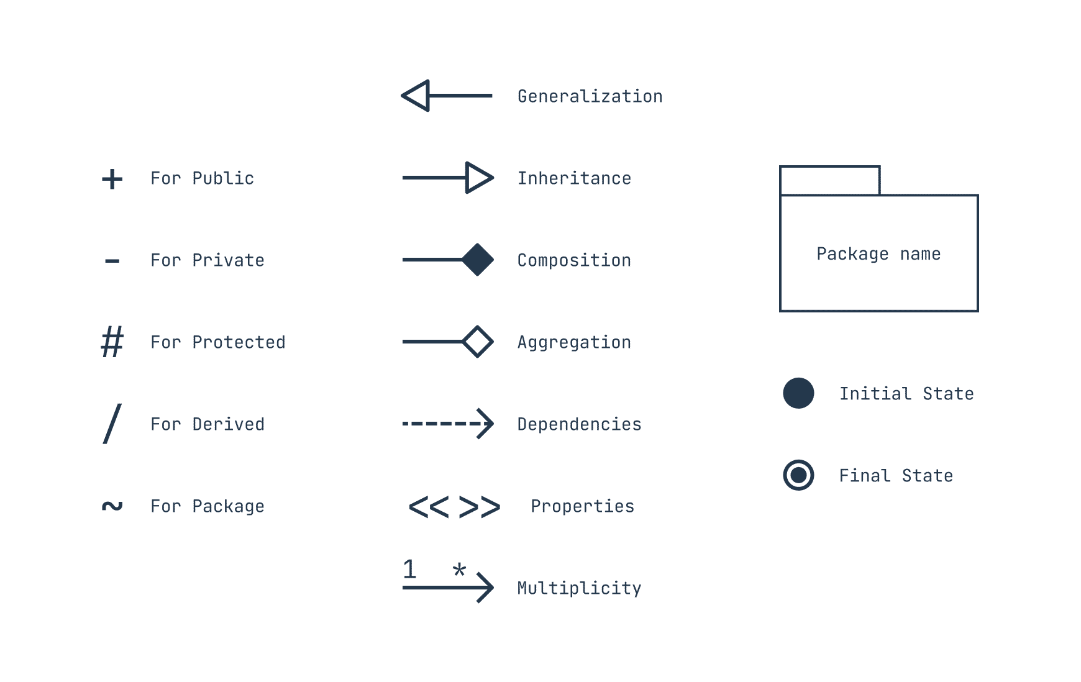
Notation in Class Diagram

Slide 9
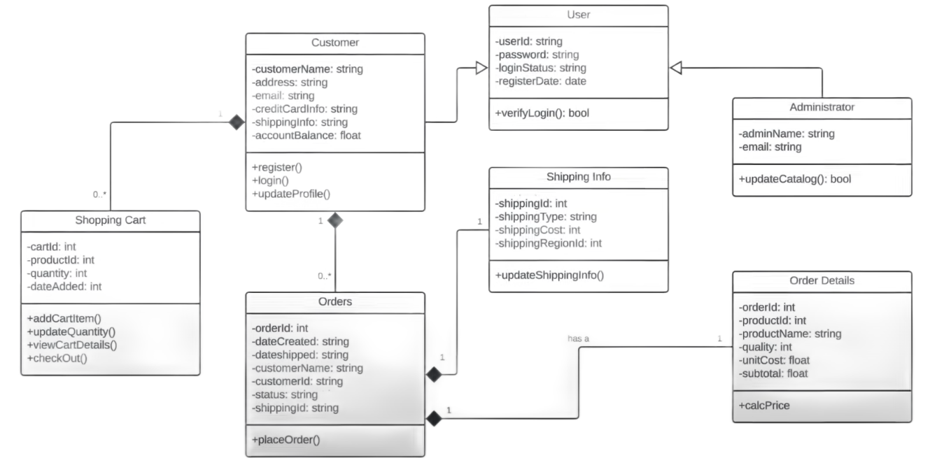
Example:

Slide 10
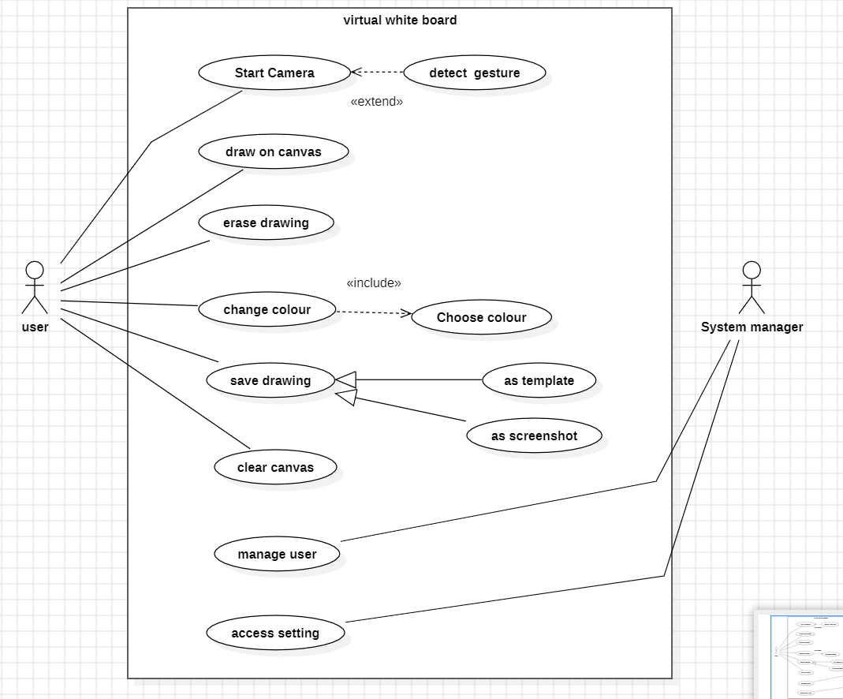
Use case diagram for virtual white board

Slide 11
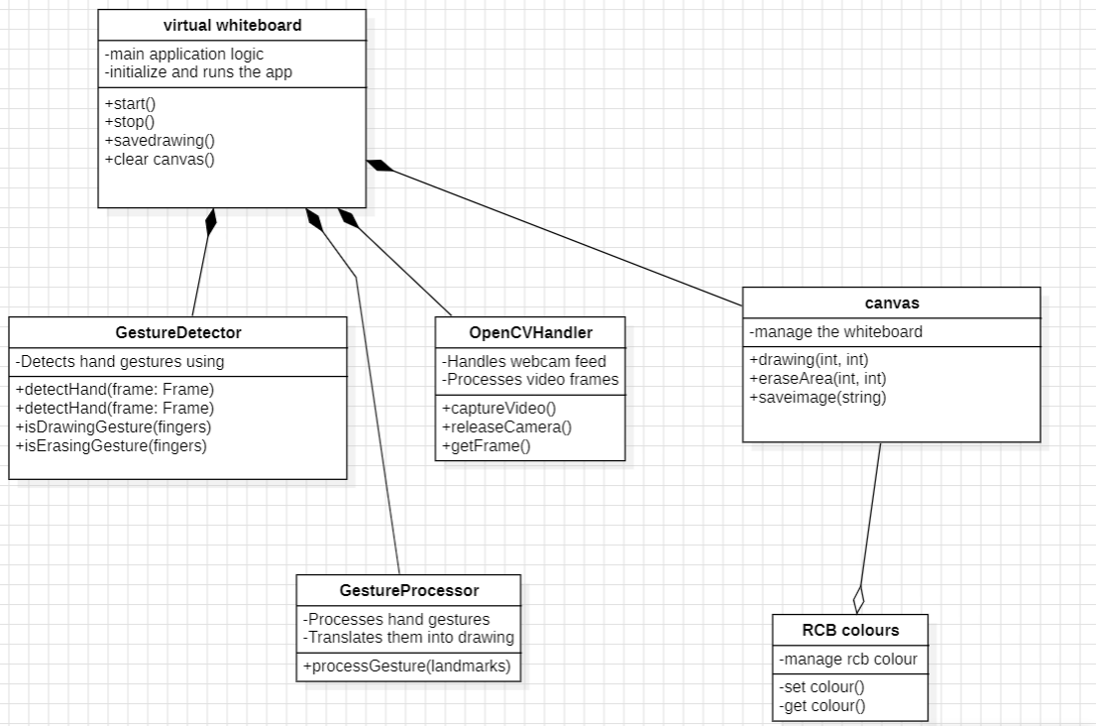
Activity diagram for Virtual white board

